Slide 1
Analysis reports for
Shop satisfaction survey dataset
Niko Kahila
Aki Sartolahti
Sami Id

Slide 2
Background of the survey
The survey was conducted by interviewing 102 customers of our shop between 1.1.2022 and 14.1.2022 (These are imaginary!!!)
We took every 100th customer that entered our shop and did the survey in such a way that equal amount of customers were interview between 9 am – 12 am, 12 am – 3 pm, 3 pm - 6 pm and 6 pm – 9 pm
All the participants got movie tickets for their effort
… whatever other information would be needed, needs to be written down here…

Slide 3
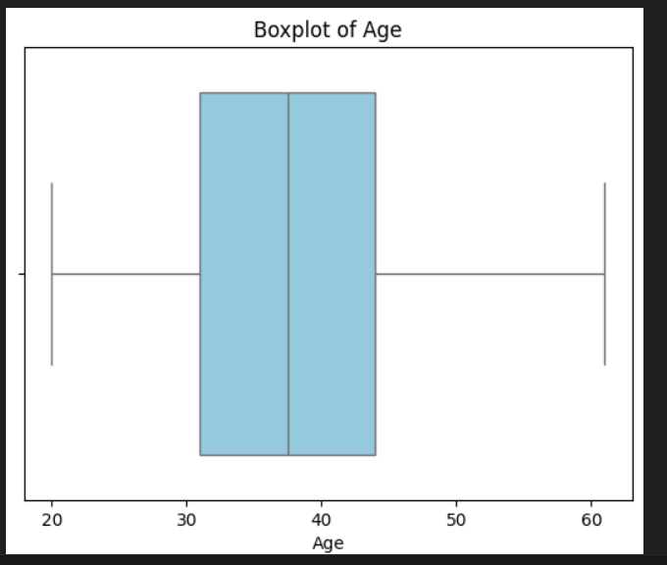
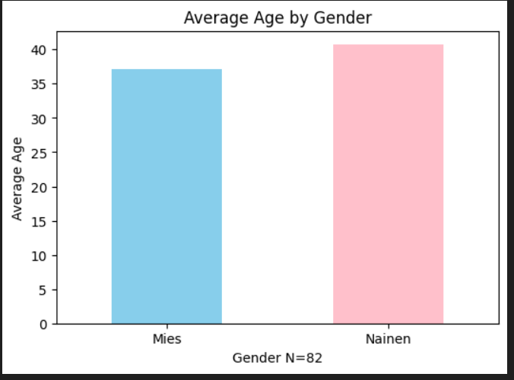
Ikä
Niko Kahila

Slide 4
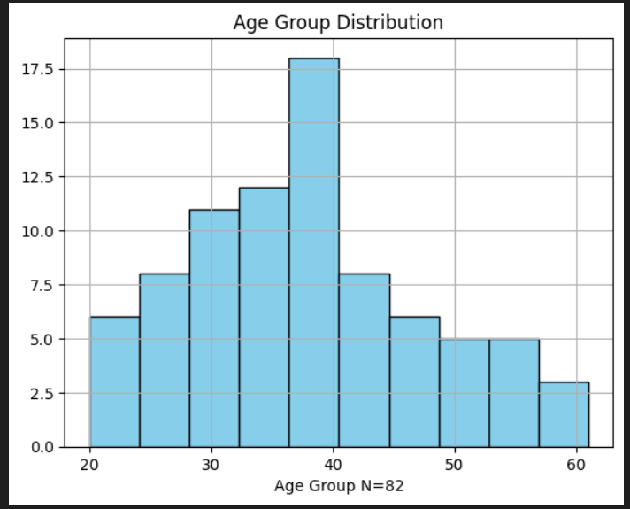
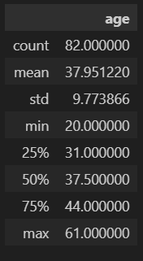
Ikä jakautuminen
Niko Kahila
Taulukot näyttävät Ikä ja sukupuoli jakauman josta huomaa että yhtiössä työskentelee 20-61 iän välillä joista keskimäärin suurin osa henkilöistä ovat myöhäis- kolmekymppisiä joten yhtiössä työskentelee melko nuoria työntekijöitä.

Slide 5
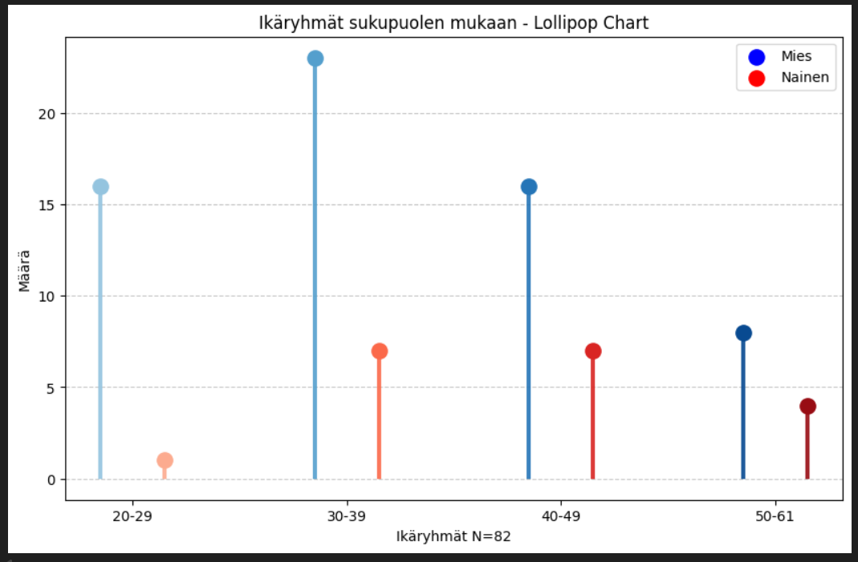
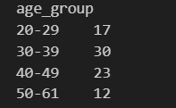
Ikä jakautuminen luokissa

Slide 6
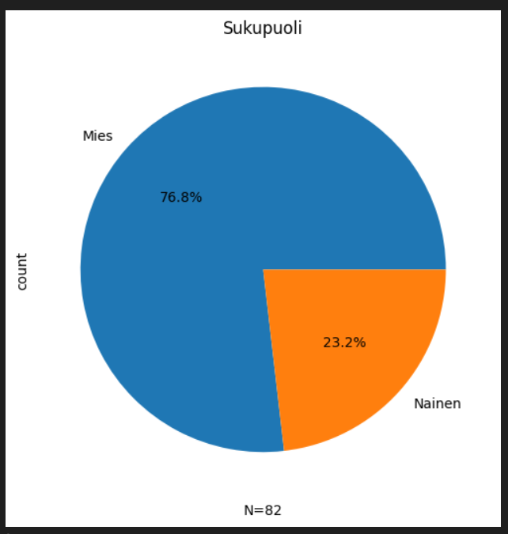
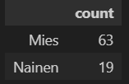
Naisten ja miesten jakautuminen
Niko Kahila
Yhtiössä työskentelee enimmäkseen miehiä.

Slide 7
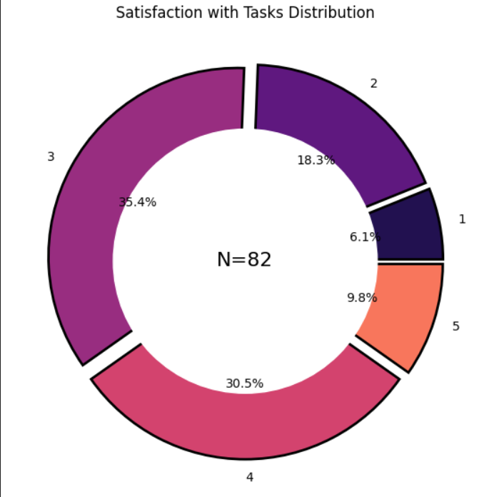
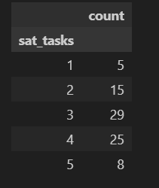
Työtehtävä tyytyväisyys
Niko Kahila
Taulukosta voi päätellä että työntekijät ovat enimmäkseen tyytyväisiä heidän työtehtäviin.

Slide 8
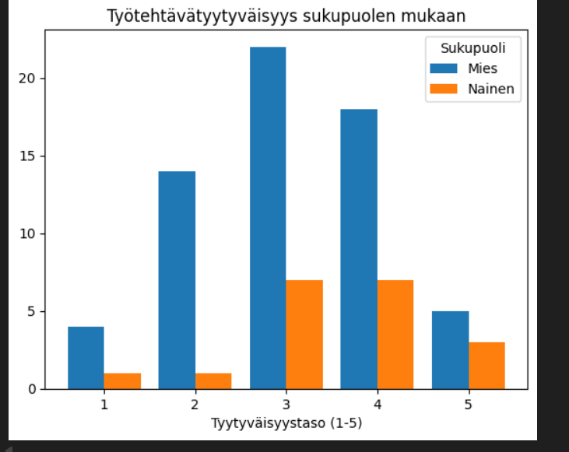
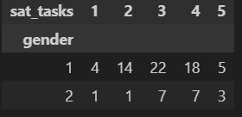
Niko Kahila
chi2 p arvon 0.46 perusteella sukupuolen ja työtehtävätyytyväisyyden välillä ei näytä olevan tilastollista riippuvuutta

Slide 9
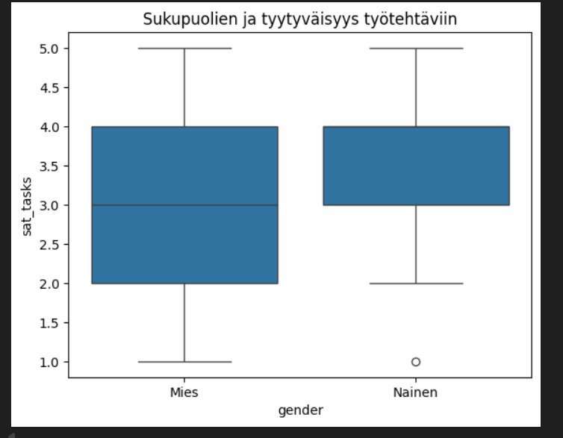
Niko Kahila
Molempien sukupuolien puolella näyttää olevan keskimäärin melko tyytyväisiä työtehtäviinsä, paitsi yksi epätyytyväinen poikkeama löytyy naisten puolella.

Slide 10
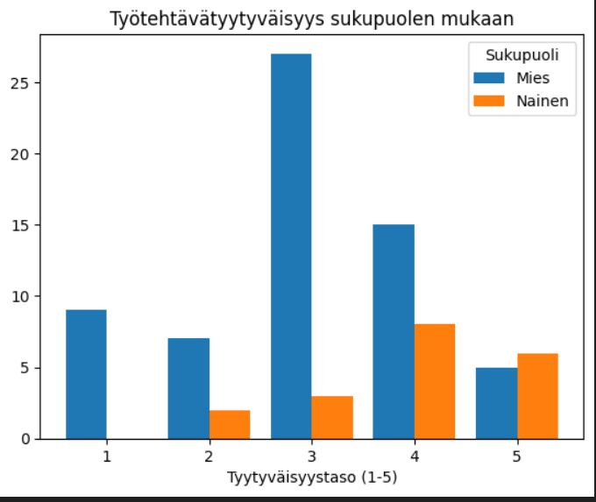

Työympäristön tyytyväisyys
Niko Kahila
Chi2 Testin tulos oli 0.009 mikä tarkoittaa että sukupuolen ja työympäristö tyytyväisyyden välillä näyttäisi olevan riippuvuutta.

Slide 11
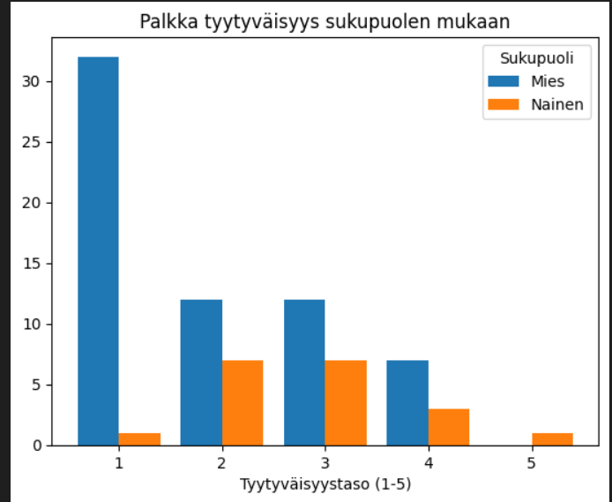
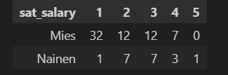
Palkka tyytyväisyys
Niko Kahila
Tilastoista huomaa heti että moni miehistä eivät ole tyytyväisiä saamaansa palkkaansa.
Chi2 testi tulos oli 0.004 mikä tarkoittaa että Palkka tyytyväisyyden ja sukupuolen välillä on riippuvuus.

Slide 12
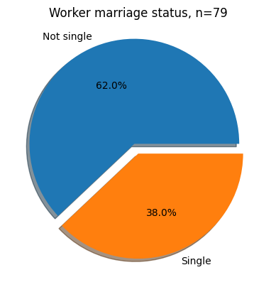
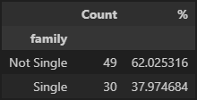
Background analysis (Marriage status)
Aki Sartolahti
Based on the survey, the majority of workers are married of otherwise in a relationship.

Slide 13
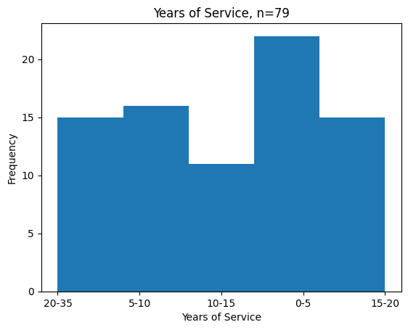
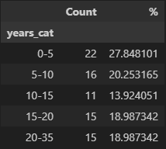
Background analysis (Years of service)
Aki Sartolahti
Most workers appear to stay around 0-5 years on the job.

Slide 14
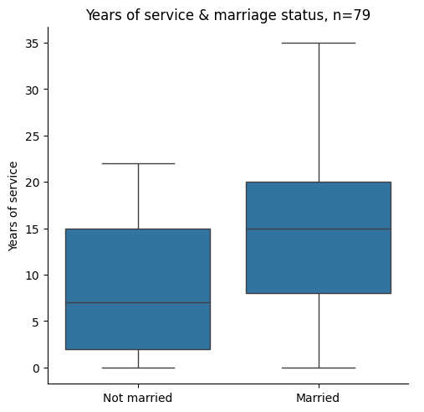
Background analysis (Marriage status & Years of service)
Aki Sartolahti
Based on the survey, there is a correlation between a worker being married and the time they stay on the job, as shown in the boxplot diagram.
Based on this analysis workers who are married tend to stay working for longer number of years.
Many married workers reach a higher number of years that none of the single workers do, based on the survey data.

Slide 15
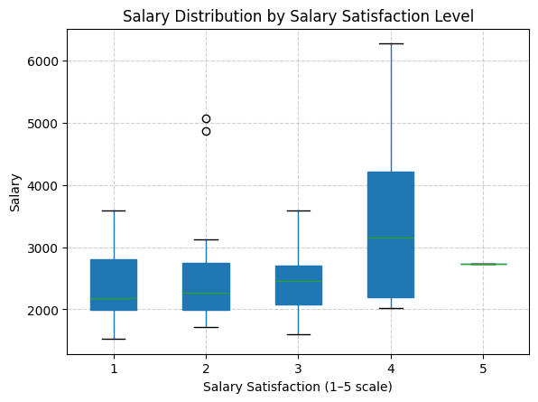
Salary Distribution
Sami Id
Survey shows a few things, firstly higher salary usually means higher satisfactory too
Most employees falls under 4 satisfactory rating, no matter how high or low their salaries are
Almost nobody falls under 5 satisfactory rating but many do under 1 rating

Slide 16
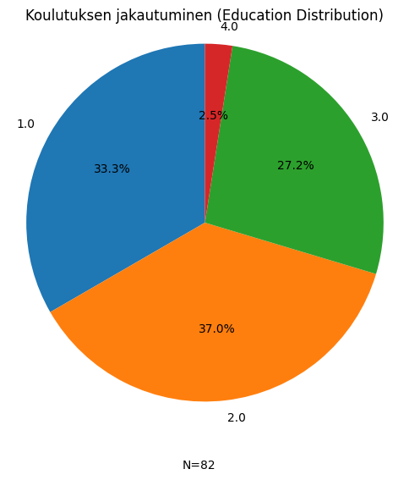
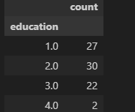
Education Distribution
Sami Id
This diagram shows that company has low education level employees the most (1 & 2)
It also shows that there are only a few employees above 3 education level

Slide 17
Background analysis (variable by variable)

Slide 18
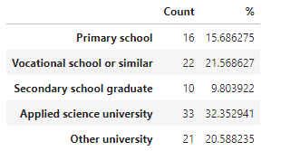
Background analysis (Education variable)
Based on the survey the educational levels of our customers are distributed based on the percentage table shown here.
More analysis/explanation goes here…
Or maybe better to use percentages in this case….

Slide 19
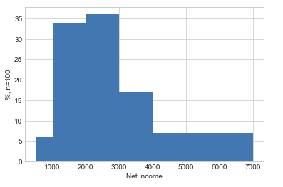
Background analysis (Net house income variable)
Since boxplot does not describe the customer net house income fully the histogram of that variable is provided here. The income classes used where
500 - 1000
1000 – 2000
2000 – 3000
3000 – 4000
4000 – 7000
We can see that about 70% of our curtomers net house income is between 1000 and 300 euros and also 3000 – 4000 e net income is rather common.
Maybe some suggestions based on your findings… (no need now for this course!)

Slide 20
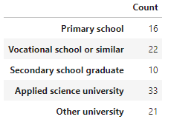
Background analysis (Education variable)
Based on the survey the educational levels of our customers are distributed based on the frequency table shown here.
More analysis/explanation goes here…

Slide 21

Background analysis (more ….)
Report other relevant findings here…

Slide 22
Analyzes two qualitative variables
Maybe there are some variable pair of variables 1-7 that provide meaningful background information for the business already
However, remember that your boss is most interested in findings with variables 1-7 together with variables 8 and 9!
Here I will report analysis between variables gender and education… Which does not have much if any meaning for the business here … but just for the illustration.
… So it is your job to analyze something interesting for your boss!!

Slide 23
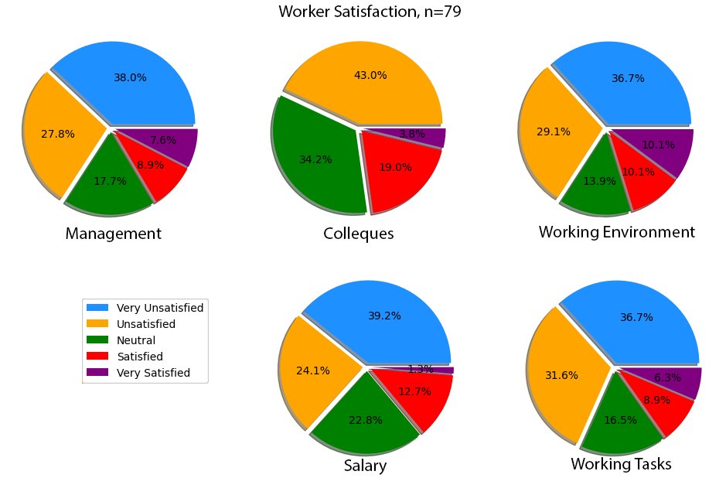
Worker Satisfaction
Aki Sartolahti

Slide 24
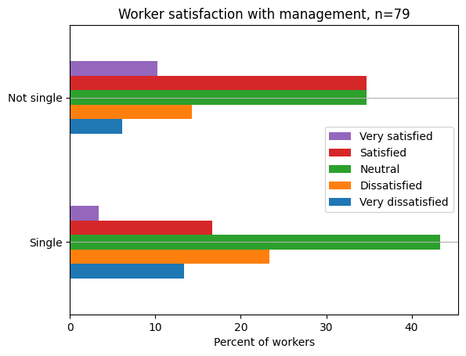

Management Satisfaction & Marriage status
Aki Sartolahti
This bar plot shows the relationship between the workers satisfaction with management and their marriage status.
Married workers tend to be more satisfied than single workers
Using a Chi2 test shows a p value of ~0.22, so no dependency in management satisfaction and marriage status.

Slide 25
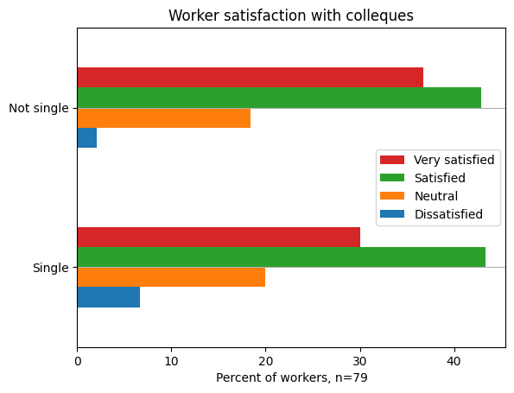

Colleque Satisfaction & Marriage status
Aki Sartolahti
This bar plot shows the relationship between the workers satisfaction with their colleques and their marriage status.
Most workers gave a positive score
Nobody gave a Very dissatisfied grade in this category
Chi2 test gave a p-value of ~0.72, showing no dependency in these variables

Slide 26
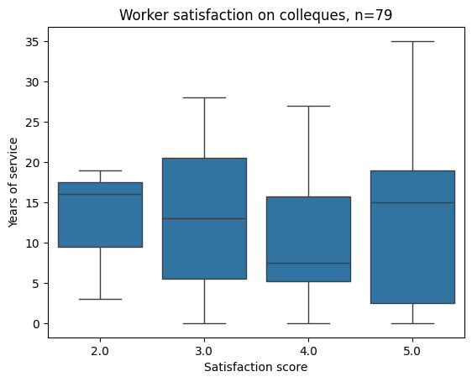
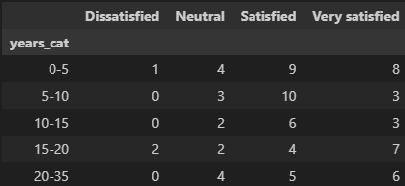
Analyzing dependency between years of service and colleque satisfaction
Aki Sartolahti
The relationship between work years and colleque satisfaction mostly increase with work years, and is mostly positive across the board
Chi2 test with the work years categorized shows a p-value of ~0.52 no dependency with the variables
…

Slide 27
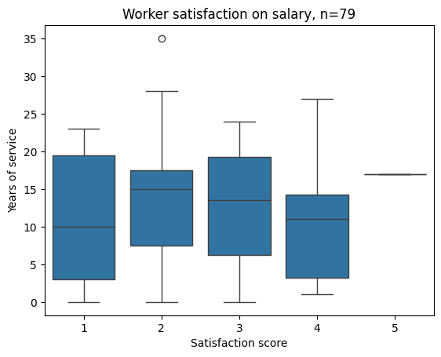
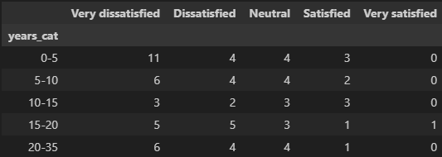
Analyzing dependency between years of service and salary satisfaction
Aki Sartolahti
The relationship between work years and salary satisfaction skews toward dissatisfied, without much visible effect on years worked.
Running the chi2 test with the work years categorized gave a p-value of ~0.88, no dependency with the variables
…

Slide 28
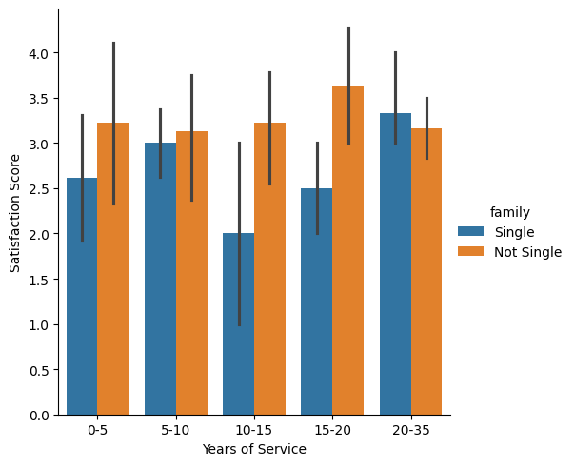
Management Satisfaction, years of service & marriage status
Aki Sartolahti
This categorical plot shows the relationship between the workers satisfaction with management, their years of service, and their relationship status.

Slide 29
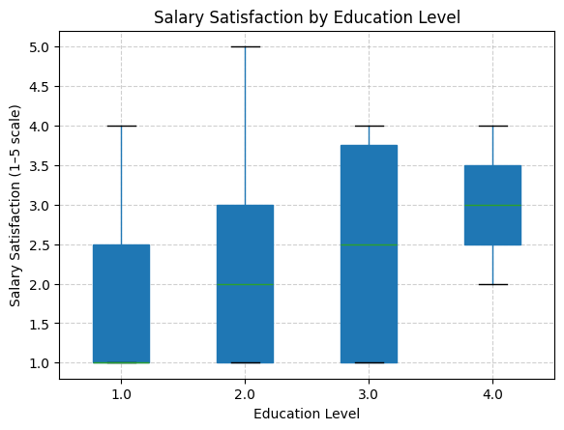
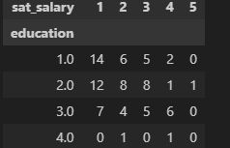
Analyzing Salary Satisfactory and Education Level
Sami Id
Based on this diagram employees with higher education level are more happy
We can also see that there are employees with 3 education level the most inside this company

Slide 30
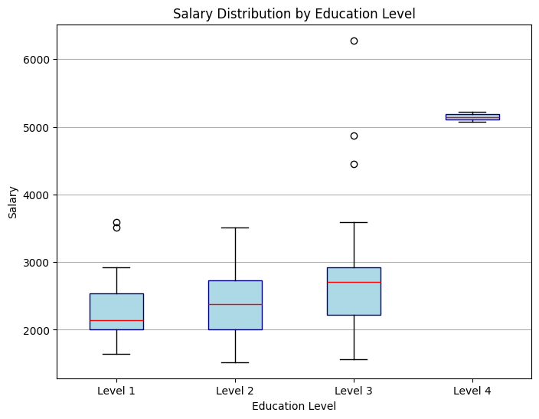
Analyzing Salary Distribution and Education Level
Sami Id
Based on this diagram employess with level 4 education are earning much more than the rest
There are about as much employees with level 2 education as level 3 education, and level 3 employees have a slightly higher salary

Slide 31
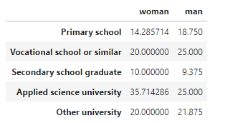

Analyzing dependency between variables gender and education
Note! This may not make much sense for the business we are dealing with here. But this is just for an example. Your job is to find meaningful dependencies from the data and report them to your boss/me

Slide 32
Analyzing dependency between variables gender and education
Note! This slide is just for illustration
Actually we did not find anathing interesting here that should be actually reported!
It is your job to find something meaningful for the business with the dataset used for the Project Work!!
Here we analyze, whether there is dependency between variables gender and education.
Out of all women, 14.3% of them has their highest education level as primary school. This is bit less than for men.
The respective values seem to be rather close in all the educational levels and we suspect there is no dependency between the variables
This was tested with Chi2 test which gave us the p-value of 0,85 which tell us that there is no dependency between the two variables.

Slide 33
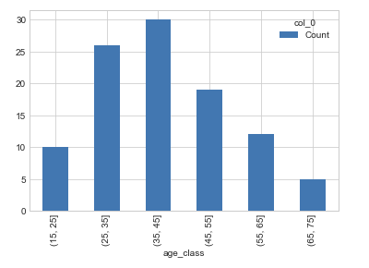
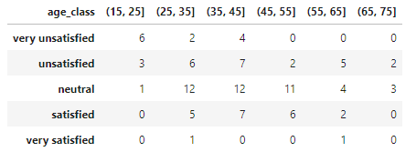
Analyzing dependency between age_groups and sat_price_level
The figure here shows the the age classes that we used in our analysis – the counts are shown also
The crosstabulation is given in the table on the right
Based on the cross tabulation it seems that for example that our youngest customers and mostly unsatisfied or even very unsatified with our price levels.
…
We suggest that we make a campaign for our youngest customers of some kind…

Slide 34
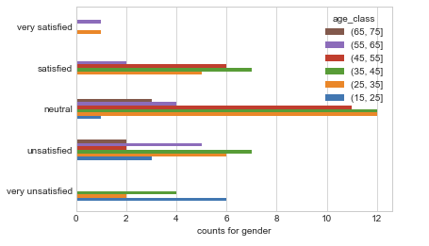
Analyzing dependency between age_groups and sat_price_level
We made a proper test for these variables. The p-value for the test was ~0.0036 so the level of dependency between the two variables is statistically significant.
By examining the data we can see that, for example, our youngest customers are the most unsatisfied age group what comes to the price level.
…
…

Slide 35
Continue with your other findings
When you are done with analysing and you have done this powerpoint accordingly, make the Project work video where you discuss this PowerPoint and especially your findings clearly.
Remember to see the Project Work guidelines fully for other things to be discussed on the video also!!

